Slide 1
Treating (and Getting Paid) in Personal Injury Cases
by Michael P. McCready

Slide 2
Sorry, PI Cases
collect on is
being difficult to
just a
Myth

Slide 3
A lien is a legal document you send to an insurance company and/or lawyer to protect your ability to be paid
Image of a lien

Slide 4
A lien protects your ability to be paid, by requiring your name is also listed on the insurance check
Patient & Doctor

Slide 5
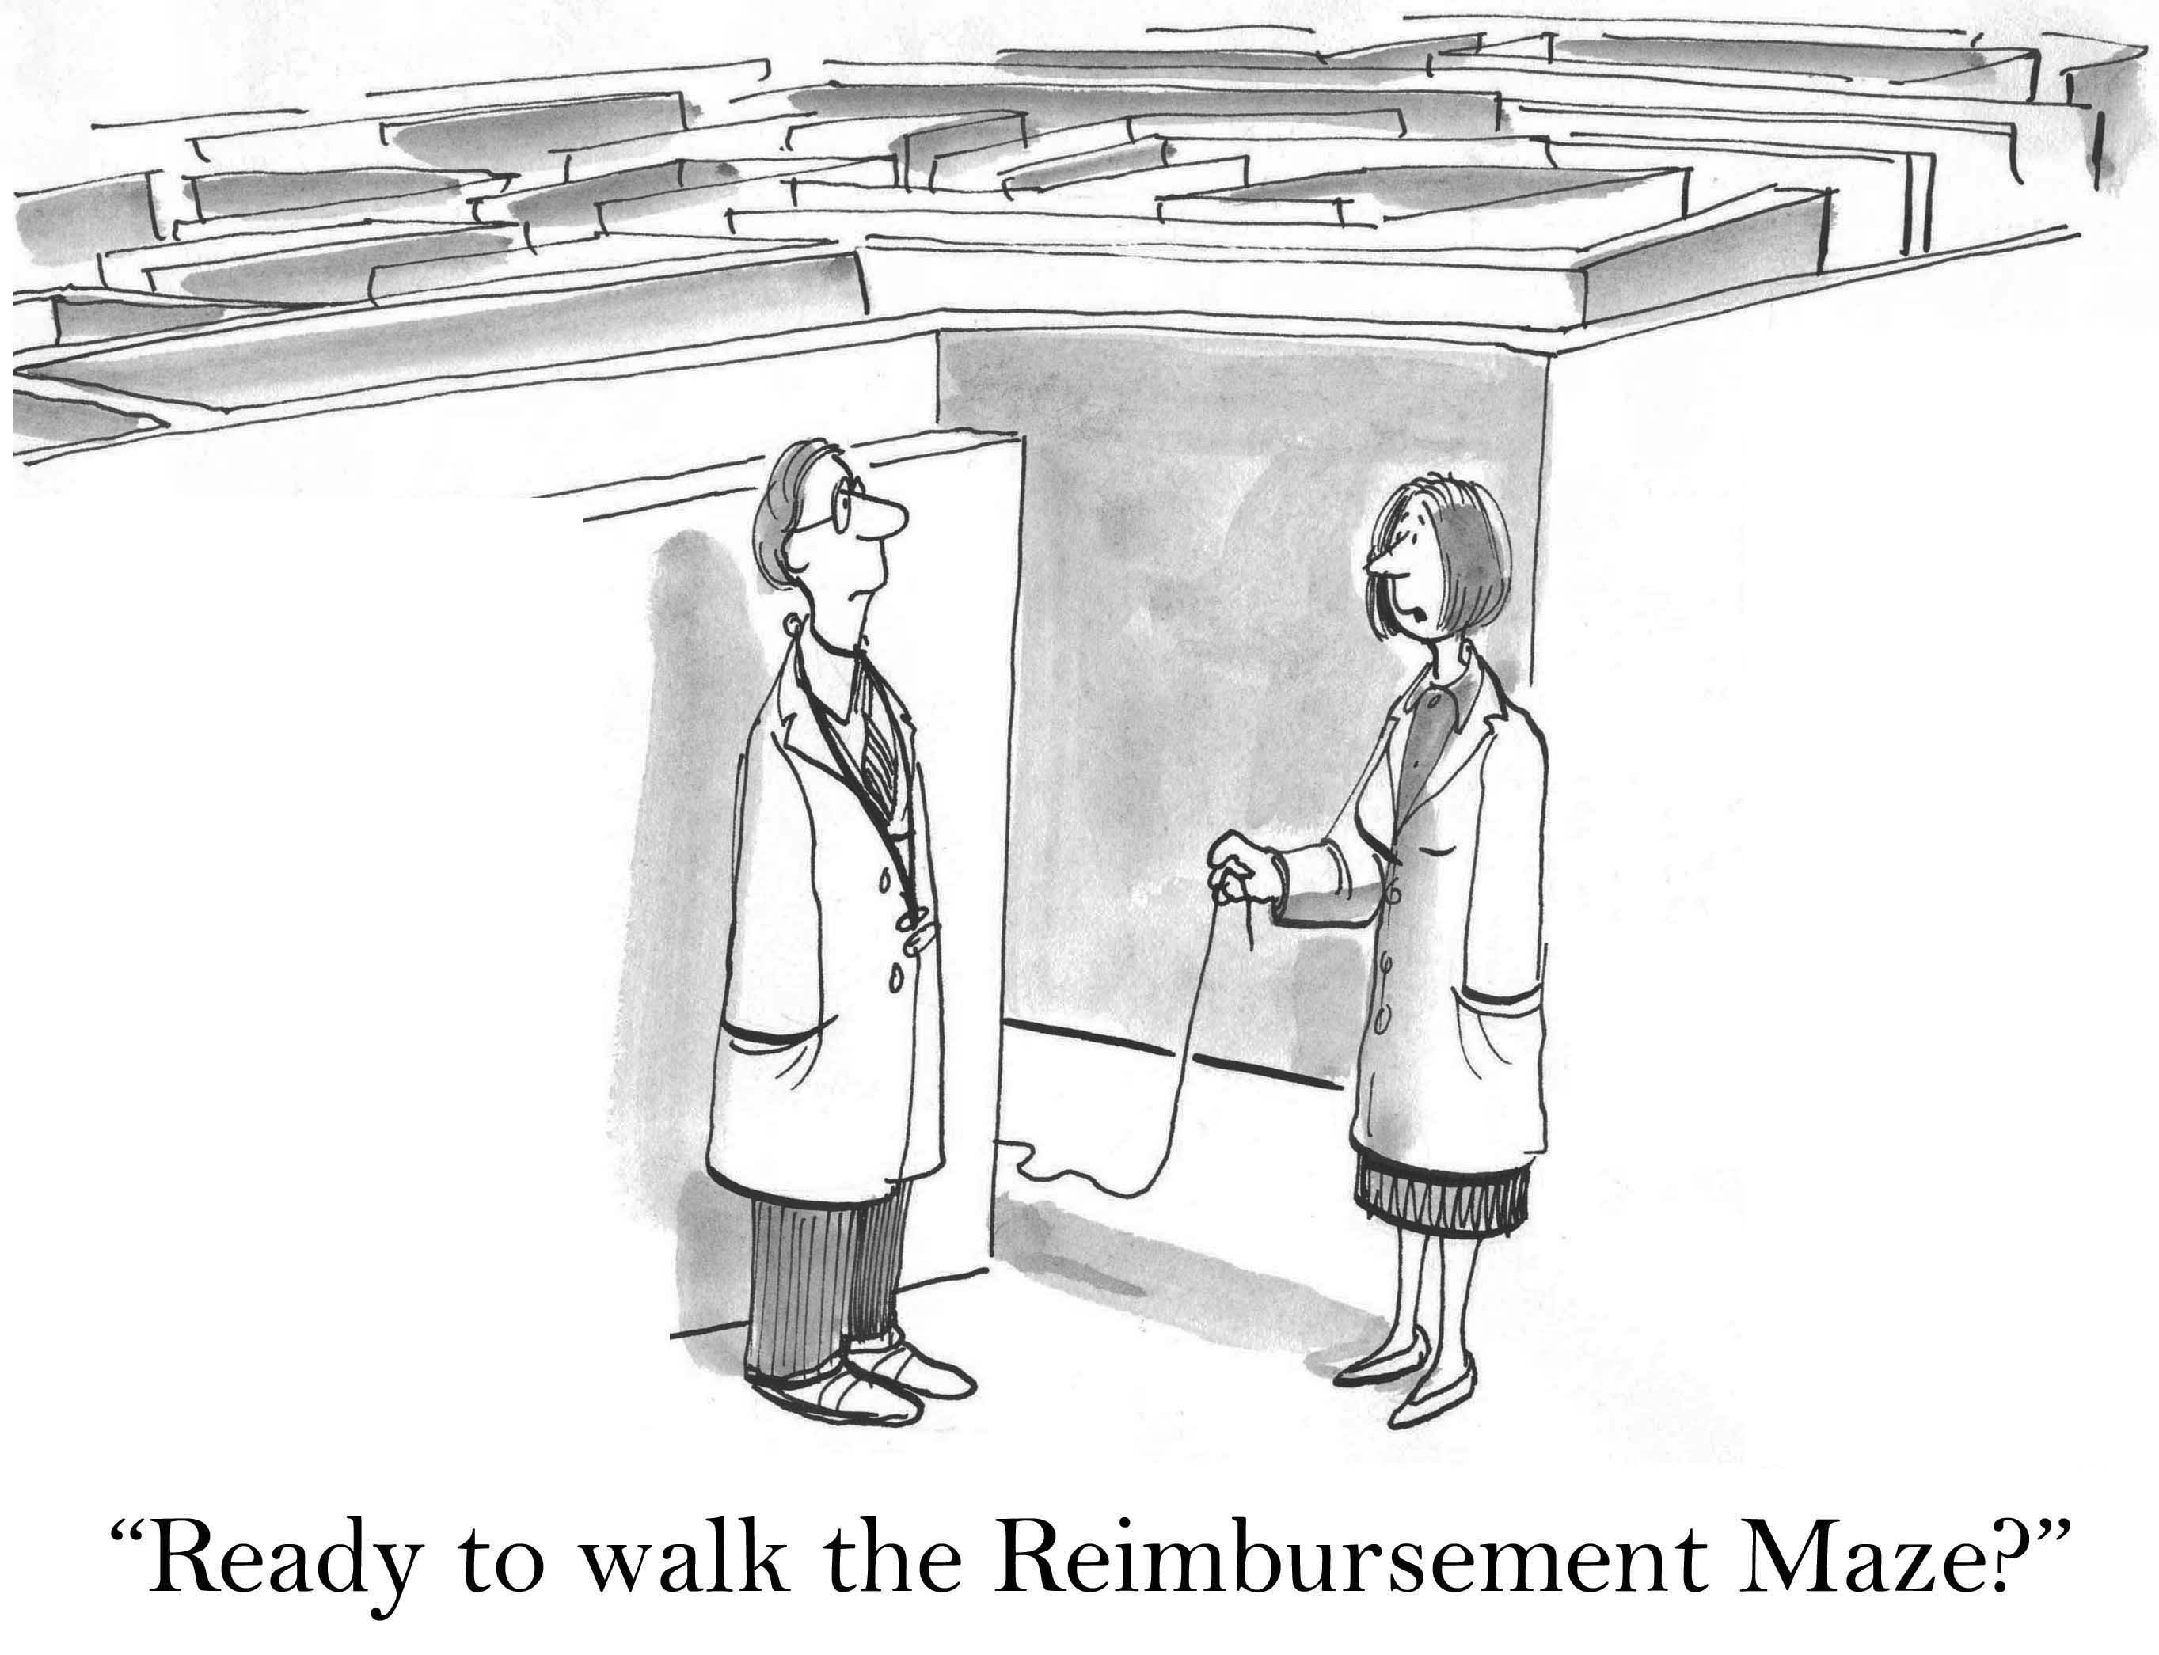

Slide 6
When Should Treatment be on a Lien Basis?
Who Will You Bill?
Health insurance
Medicaid
Public aid
Patient
NO
NO
NO
NO
May be a good time to treat the patient on a lien-basis
Notes:
Considerations: decision factors on when to treat a patient on a lien basis.
A doctor can bill health insurance or public aid or Medicaid, but if the patient does not have the means to pay for treatment, the doctor may chose to treat the patient on a lien basis

Slide 7
Lien Considerations
Liability and Property Damage
Insurance company
Patient's Attorney
Insurance Limits
Communication with attorney
Don't put yourself in position to not treat because of being paid
Treatment Limits

Slide 8
Liability and Property Damage
Fault:
Must be the other person’s
If it is your patient's fault– no recovery on lien
Damage:
Little or no property damage may cause:
No offer of settlement, which means
No recovery, resulting in
Severe case of NMSTD
(No Money Sent to Doctor)
Notes:
The only way a doctor (or patient or lawyer) will get paid is if the accident is the other person’s fault.
If it is the patient’s fault, or it is questionable as to whose fault it is, there may be no recovery.
Likewise, if it is a tiny “fender bender” with little or no property damage, the insurance company may not make an offer of settlement.
No offer of settlement means no recovery and means no payment to the doctor.

Slide 9
Know the insurance company at fault
INSURINCE
‘n
LEMONADE
Notes:
It is important to know which insurance company is potentially at fault.
It is much less likely that a doctor will get paid from a sub- standard insurance company which you have never heard of than from an established insurance company like State Farm or Allstate.

Slide 10
Patient's Attorney
Questions You Must Know the Answers to:
Does the Patient have a lawyer?
If not, are you willing to treat them for free?
Do you know the lawyer?
If not, have you researched them?
Does the lawyer:
Handle personal injury cases?
Have a reputation good or bad?

Slide 11
WARNING
Some lawyers will do anything to
screw the doctor
out of their lien

Slide 12
Insurance Limits
In
Car accident
$25,000 case minimum limits
Serious injuries
May require treatment exceeding the policy limits.
Making it less likely you’ll fully recovery your lien
Notes:
In certain circumstances, the limits of the available insurance may come into play. The minimum limits in a car accident case are $25,000. If the client has serious injuries and the treatment will exceed the policy limits, it is less likely you will make a recovery for your lien

Slide 13
Amount of Treatment
As soon as possible
Evaluate how much treatment the case will support
Treatment Level Factors
Liability
Property damage
Insurance company
Policy limits
Notes:
Amount of treatment a case will support
You must determine how much treatment the case will support as soon as possible. If there is strong liability, with a lot of property damage against a reputable insurance company with large limits, it will impact the care you will be able to provide your patient on a lien basis

Slide 14
Alternatives: Health Insurance, Medicare, Public Aid
Lien
Lien
Alternatives
Alternatives
Notes:
Health insurance, Medicare, Public Aid – if a patient has a form of payment, it is always safer to bill that then to maintain a lien. But, you will be limited in how much of your bill you will collect. On a lien basis, there is the possibility of collecting your full bill, or at least more than you would have from an alternate source
Med Pay – medical payments coverage is available in auto and premises liability cases. Med pay is payable for medical bills regardless of fault. But, there is always a limit to med pay. There may be no med pay, but typical limits are less than $5,000
Greed in getting paid – you may collect more by maintaining a lien, but there’s risk involved

Slide 15
Bill Reduction Requests: 1. Preparation
Secret
Know Your Rights
Satisfaction of lien vs. payment of full – a lien is merely a security interest for your charge.
You may accept payment to release your lien and still balance bill the patient.
To Do
Request a copy of the release and settlement sheet from the attorney to confirm settlement amount (don’t take the lawyer’s word for it)
Request a copy of the other provider reductions (don’t accept lawyer's word on reductions)
Confirm there are no other forms of recovery such as UIM or Med Pay
Find out if medical bills are paid by other sources, i.e health insurance, public aid, Medicare
in policy limits cases, lawyers often reduce the liens based on the limits and do not tell doctors there is underinsured motorist coverage for additional recovery.
Form requesting information to make decision how much to reduce

Slide 16
Bill Reduction Requests: 2. Evaluative
Secret
Find out
Why is insurance company making such a low offer
Does it correspond with expenses, attorney fees and other liens?
Review the Settlement
Settlement value drives what you get paid
All personal injury cases have settlement sheets which document disbursements.
Medical treatment = Stronger legal case = better recovery = more likely you recover full charges.
Make sure you’re not alone
Are the attorneys and/or other lienholders also reducing their fees - if so, by how much?
Other Payees
If med pay not paid to providers – it goes into settlement amount
Do not reduce your lien based on the bills paid by other sources - only on the liens
If medical payments are not paid to the providers, the attorney is likely including it in the settlement, but it will not be reflected in the settlement offer from the liability insurance company.

Slide 17
Bill Reduction Requests: 3. Acceptance
Best Practice
Keep the lawyer honest by making your reduction contingent on receiving a copy of the signed settlement sheet
Reduction based on representation of . . .
If ultimate settlement is more, this agreement is null and void
Form accepting reduction

Slide 18
Lien Act 770 ILCS 23/ Health Care Services Lien Act
Lien Act is just for liens – always ask for the liens, not the bills
Full bill, current balance, lien, agreed reduction – get this info for all the bills, it is the only way to evaluate whether your reduction is fair

Slide 19
Lien Effectiveness: Attorney Analysis
Which attorney is returning the
highest bill percentage?
Time is money!
Look for lawyers who move cases efficiently
Notes:
Just as you track your collections (you’re doing that, right?), you should track the effectiveness of your lien collections
Track your collections
Percentage collected/billed by attorney – what lawyers are paying you the highest percentage of your bill? They must be doing something right, or the others may not be treating you fairly
Average collection by attorney – in additional to the percentage, you should track your gross collections, who is making you the most money
Time from discharge to collection by attorney – time is money, the longer it takes for a lawyer to collect your lien, the less valuable it becomes, look for lawyers who move cases efficiently
Chose which attorneys to work with – who do you know, like and trust?

Slide 20
Motion to Adjudicate Lien
If a case is in litigation, a lawyer may file a motion to adjudicate your lien, essentially asking a judge to decide whether your lien is valid and how much you are entitled to receive.
In other words, the lawyer is asking the judge to screw you

Slide 21
Motion To Adjudicate Lien
If no one attends the motion you will get nothing
It is up to the doctor to prove the validity of the lien
Related to the accident
Only treatment causally related to accident can be subject to a lien.
If no one attends, there is no proof any treatment is related
Reasonable and customary charge
Only reasonable charges will be paid on lien basis,
if no one attends, there is no proof the bills are reasonable
Personally attend vs. counsel
Although often overlooked, you are not allowed to personally attend if you are incorporated
Favor from attorney
Since motions to adjudicate are rare, time to call in a favor

Slide 22
Remedies if you’re not paid
Research
Request a copy of the insurance check and verify your name was included
Write to the patient’s attorney
Friendly inquiry letter first, if no results
Get your “mean hat” on with a nasty letter
Turn over to your attorney
Time to call in another favor
Contact your patient
They are often unaware their lawyer is stiffing you – but don’t be surprised to learn they are the driving force
ARDC
Consider contacting the lawyer disciplinary board if the lawyer is ignoring your lien
Notes:
Request copy of check from insurance company – see if your name was included on the check, if it was not, insurance company may be responsible to pay you
Hold harmless statute – law which allows lawyer to certify he will hold all insurance company money while addressing liens – you think this happens?
Nasty letter – if a lawyer has stiffed you on your lien, there;s no reason to think they will respond to a friendly inquiry (though you should try this first), it’s time to get your mean hat on
Turn over to attorney – time to call in another favor
Contact client – sometimes, the client is unaware that their lawyer is stiffing the doctor, though more frequently they are the driving force.
ARDC – if a lawyer has ignored your lien, it may be time to contact the lawyer disciplinary board

Slide 23
Hold harmless statute
Lawyers can certify they will hold the insurance money while addressing liens – you think this happens?
Hold harmless statute

Slide 24
WARNING
Some lawyers will do anything to
screw the doctor
out of their lien
Remember Me?

